Slide 1
Chapter 1: Introduction
(OS Structure, Modes and Services)
By: Navjot Kaur

Slide 2

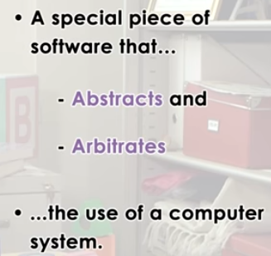
OPERATING SYSTEM?
Abstract: To simplify how hardware actually looks like.
Arbitrate: To manage , to oversee the hardware use

Slide 3
What is an Operating System?
It is a layer of system software that:
  directly has privileged access to underlined hardware
  hides hardware complexity
  manages hardware on behalf of one or more applications according to policies.

Slide 4
What is an Operating System?
What is an Operating system?
  A program that acts as an intermediate/ interface between a user of a computer and the computer hardware.
  Resource allocator (Managing the resources efficiently)
  Control Program
Operating system goals:
  Execute user programs and make problem solving easier.
  Make the computer system convenient to use
  Efficiently use available resources

Slide 5
What is an Operating System?
An operating system is the one program that is running at all the times on the computer- usually called the kernel.
Kernel is a program that (allow) let the hardware to recognize and read the program/process.

Slide 6
Computer System Structure
Computer system can be divided into four components:
  Hardware – provides basic computing resources
    CPU, memory, I/O devices
  Operating system
    Controls and coordinates use of resources among various applications and users
  System/Application programs – define the ways in which the system resources are used to solving user problems
    Word processors, compilers, web browsers, database systems, video games
  Users
    People, machines, other computers

Slide 7

Four Components of a Computer System

Slide 8

Computer System Organization
Computer-system
  One or more CPUs, device controllers connect through common bus providing access to shared memory
  Concurrent execution of CPUs and devices competing for memory cycles

Slide 9
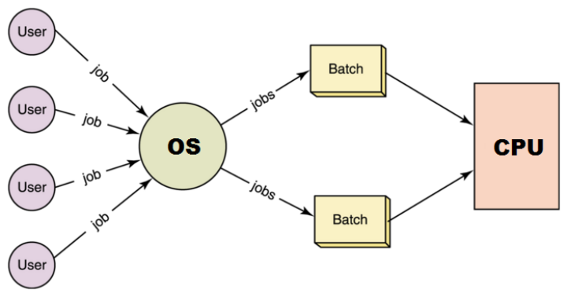
TYPES OF OS
Batch Systems
“Batch operating system” The users of a batch operating system do not interact with the computer directly.
Each user prepares his job on an off-line device like punch cards and submits it to the computer operator.
To speed up processing, jobs with similar needs are batched together and run as a group.

Slide 10
TYPES OF OS: Batch Systems
There is no direct interaction between user and the computer.
The user has to submit a job (written on cards or tape) to a computer operator.
Then computer operator places a batch of several jobs on an input device.
Jobs are batched together by type of languages and requirements.
Then a special program, the monitor program, manages the execution.
Disadvantages:
No interaction between user and computer.
No mechanism to prioritize the processes

Slide 11
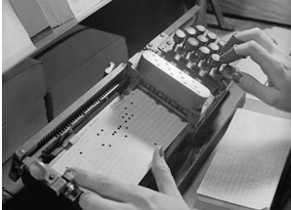
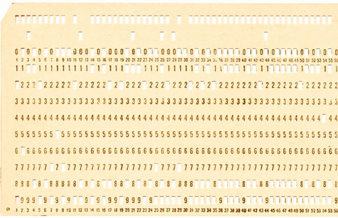
TYPES OF OS: Batch Systems
Early computers were machines run from a console
The common input devices were card readers and tape drives.
The common output devices were line printers, tape drives, and card punches.
User Prepares a JOB (Program) using Punch Cards → Computer
Operator→ Wait for Output

Slide 12
Multiprogrammed OS
  Multiprogramming: When 2 or more processes reside in memory at the same time
  Single user processes cannot keep CPU and I/O devices busy at all times
  Multiprogramming organizes jobs (code and data) so CPU always has one to execute
  Multiprogramming assumes a single shared processor. One job selected and run via job scheduling
  Multiprogramming increases CPU utilization.
  It is mixture of I/O bound and CPU bound processes

Slide 13
Multiprogrammed OS
In this the operating system picks up and begins to execute one of the jobs from memory.
Once this job needs an I/O operation operating system switches to another job (CPU and OS always busy).
Jobs in the memory are always less than the number of jobs on disk(Job Pool).

Slide 14
Multiprogrammed OS
If several jobs are ready to run at the same time, then the system chooses which one to run through the process of CPU Scheduling.
In Non-multiprogrammed system, there are moments when CPU sits idle and does not do any work.
In Multiprogramming system, CPU will never be idle and keeps on processing.

Slide 15
Multiprogrammed OS
  CPU scheduling is the basis of multiprogramming operating systems

Slide 16
Multitasking/Timesharing OS
Timesharing (multitasking) when multiple jobs are executed by the CPU simultaneously by switching between them.
  There is at least one program is executing in memory process
  If several jobs ready to run at the same time  CPU scheduling
  If processes don’t fit in memory, swapping moves them in and out to run
  Only one CPU is involved, but it switches from one process to another so quickly that it gives the appearance of executing all of the processes at the same time.

Slide 17
Multitasking/ Time Sharing
Types of Multitasking:
Preemptive: the operating system parcels CPU time slices to each program.
Cooperative: each program can control the CPU for as long as it needs it.
  If a program is not using the CPU, however, it can allow another program to use it temporarily.
  In time sharing systems the prime focus is on minimizing the
  response time, while in multiprogramming the prime focus is to
  maximize the CPU usage.

Slide 18
Multiprocessing OS
A multiprocessor system consists of several processors that share a common physical memory.
Multiprocessor system provides higher computing power and speed.
In multiprocessor system all processors operate under single operating system.

Slide 19
Multiprocessing OS
Multi-processor systems; that is, they have multiple CPU.
Also known as parallel systems or tightly coupled systems
Such systems have more than one processor in close communication, sharing the computer bus, the clock, and sometimes memory and peripheral devices.

Slide 20
Distributed Systems
A network is a communication path between two or more systems.
Each system over the network keeps copy of the data, and this leads to Reliability (Because if one system crashes , data is not lost).
CLIENT SERVER SYSTEMS
PEER TO PEER SYSTEMS

Slide 21
Real Time Systems
Time bound systems
Real time systems are of 2 types:
1. Soft Real time Systems: Process should complete in specific time but May have some delay (Positive delay) and will not harm the system.
Exp: Session expires but can be re-logged in.
2. Hard Real Time Systems: Each process is assigned a specific time instance, and Process must complete in that time otherwise system will crash.

Slide 22
Operating System Views
OS can be explored from 2 view points:
1. User view:
  The goal of the Operating System is to maximize the work and minimize the effort of the user.
  Operating System gives an effect to the user as if the processor is dealing only with the current task, but in background processor is dealing with several processes.

Slide 23
Operating System Views
OS can be explored from 2 view points:
2. System View:
Operating System is a program involved with the hardware.
OS is a resource allocator
  Allocates and Manages all resources and their sharing.
  Decides between conflicting requests for efficient and fair resource use
OS is a control program
  Controls execution of programs to prevent errors and improper use of the computer
  It prevents improper usage, error and handle deadlock conditions.

Slide 24
Operating-System Operations
OS’s are Interrupt driven. If no process, no I/o devices, No users then OS will sit quietly waiting for some event to occur.

Slide 25
Operating-System Operations
To protect OS, Dual-mode operations exist:
  User mode (1) and kernel mode (0)
  A Mode bit is added to hardware to indicate mode
    Provides ability to distinguish when system is running user mode or kernel mode
    System call changes mode to kernel, return from call resets it to user

Slide 26
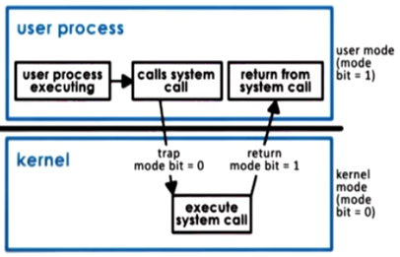
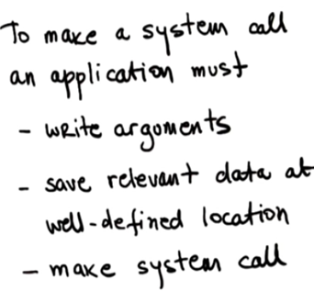
Transition from User to Kernel Mode

Slide 27
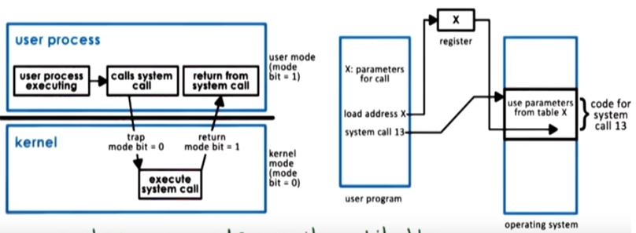
Transition from User to Kernel Mode

Slide 28
Operating System Structure
Various ways to structure a system

Slide 29
Q1. Which program controls the execution of programs to prevent errors and improper use of computer?
a) Resource allocator
b) Control Program
c) Hardware
d) None of the above

Slide 30
Q2. The operating system switches from user mode to kernel mode so the mode bit will change from?
a) 0 to 1
b) 1 to 0
c) Remain constant
d) None

Slide 31
Q3. In which type of operating system users do not interact directly with the computer system?
a) Multiprogramming operating systems
b) Multiprocessing operating systems
c) Batch operating systems
d) Distributed operating systems

Slide 32
Ans 3) c

Slide 33
Q4. What is the objective of multiprogramming operating systems?
a) Maximize CPU utilization
b) Switch the CPU among processes
c) Achieve multitasking
d) None of the above

Slide 34
Ans4. a)

Slide 35
Q5. Which program/unit signalled for the occurrence of an event either from the hardware or the software?
a) Bootstrap program
b) Interrupt
c) Disk Controller
d) CPU

Slide 36
Ans5: b

Slide 37
Q6. In which type of I/O interrupts the control return to the user program after the completion of I/O operation?
a) Synchronous I/O interrupts
b) Asynchronous I/O interrupts
c) System Call
d) Hardware

Slide 38
Ans 6) a

Slide 39
Q7: The device-status table contains
a) each I/O device type
b) each I/O device state
c) each I/O device address
d) all of the above
(d)

Slide 40
Ans 7 (d)

